Slide 1
Adaptive Batch Size and
Learning Rate Scheduling
for Efficient CNN Training
Deep Learning Midterm Project
Tharun Swaminathan Ravi Kumar • Dev Gurung • Jiong Zhang
Current midterm study: feedback-driven batch growth + adaptive LR on CIFAR-10 and CIFAR-100
Notes:
Open with the project question: instead of fixing batch size and learning rate for the whole run, can we let training behavior decide when they should change?
This midterm presentation compares the same E1–E4 experiment design on CIFAR-10 and CIFAR-100 using the current DeeperCNNWide model. The results shown here are validation-selected midterm results, not a statistical claim of universal superiority.

Slide 2
Why adapt batch size and learning rate?
Training efficiency and model quality pull SGD in different directions.
MOTIVATION
Small batches
Large batches
Learning rate
• More frequent parameter updates
• Noisier gradients can aid exploration
• Lower memory footprint
• Less parallel work per step
• Fewer optimizer updates per epoch
• More parallelism / throughput potential
• Lower gradient variance
• Diminishing returns beyond a useful scale
• Controls step magnitude
• Interacts with batch size and noise
• Often needs decay or warmup
• A fixed schedule may react too late
Research question
Can validation behavior and gradient stability drive batch-size and learning-rate changes that improve the accuracy–efficiency tradeoff?
Notes:
Use this slide to motivate the tradeoff. Small batches give more frequent, noisier updates; large batches reduce the number of optimizer steps and can improve hardware utilization, but they may lose useful stochasticity.
Learning rate interacts with that choice, so our research question is whether validation behavior and gradient stability can drive both quantities dynamically.

Slide 3
Literature review I — the large-batch debate
The literature moved from “large batches hurt” toward a more conditional view.
LITERATURE
2017
2017
2017
2018
Keskar et al.
Hoffer et al.
Goyal et al.
Masters & Luschi
Large-batch training was associated with sharper minima and worse generalization.
The gap can shrink when large-batch runs receive enough optimizer updates / longer training.
Large ImageNet batches can work with learning-rate scaling and gradual warmup.
Small batches can provide more stable optimization and a wider stable LR region.
2019
Shallue et al.
Takeaway
Batch size cannot be judged in isolation. Learning rate, number of updates, model, dataset, and training budget all change the outcome.
Batch scaling shows diminishing returns; tuning and compute budgets explain many disagreements.
Sources: Keskar et al. (2017); Hoffer et al. (2017); Goyal et al. (2017/2018); Masters & Luschi (2018); Shallue et al. (2019).
Notes:
Summarize the large-batch debate chronologically. Keskar connected large batches with sharper minima, while Hoffer showed that fewer optimizer updates can explain much of the apparent generalization gap.
Goyal showed that large batches can work with careful LR scaling and warmup, and Masters & Luschi emphasized the stability of smaller batches. Shallue then showed that useful batch size depends strongly on the workload and training budget.

Slide 4
Literature review II — from scaling rules to adaptive training
The papers most directly connected to our controller motivate joint, dynamic control.
LITERATURE
Study
Core result
How it shapes our design
Smith et al. (2018)
Increasing batch size can replace parts of LR decay while reducing parameter updates.
Treat batch size and LR as coupled.
AdaBatch — Devarakonda et al. (2018)
Start small, progressively increase batch size, and gain efficiency with similar accuracy.
Grow batch rather than selecting one static value.
McCandlish et al. (2018)
Gradient noise scale predicts a useful batch-size region and can change during training.
Use training dynamics as a signal for batch adaptation.
Shallue et al. (2019)
Maximum useful batch size is workload-dependent; simple LR scaling rules are not universal.
Use bounded, empirical adaptation instead of assuming one global rule.
Important distinction
Our “gradient-norm stability” signal is a coefficient of variation of minibatch gradient norms — it is not McCandlish et al.’s formal gradient noise scale.
Sources: Smith et al. (2018); Devarakonda et al. (2018); McCandlish et al. (2018); Shallue et al. (2019).
Notes:
This slide connects the literature directly to our design. Smith motivates treating batch size and learning rate as coupled variables; AdaBatch motivates progressive batch growth; McCandlish motivates using training dynamics rather than one fixed batch size.
Be precise with terminology: our signal is gradient-norm coefficient of variation, or gradient-norm stability. It is not McCandlish et al.'s formal gradient noise scale.

Slide 5
Our midterm contribution
A controlled four-way comparison with feedback-driven controllers.
RESEARCH GAP
Prior approaches often use fixed batch sizes, predefined schedules, or large-scale distributed recipes.
Factorial experiment design
We trigger batch growth from validation plateau + gradient-norm stability.
E1
Fixed batch
Fixed LR
E2
Adaptive batch
Fixed LR
We trigger LR decay from validation loss/accuracy feedback.
In E4, the LR is recomputed using the batch selected for the next epoch.
E3
Fixed batch
Adaptive LR
E4
Adaptive batch
Adaptive LR
We measure accuracy, loss, macro-F1, optimizer updates, and time-to-target.
Same split within each dataset • same model • same seed • same optimizer family • fixed dataset-specific budgets (80 / 120 epochs)
Notes:
Explain the factorial design: E1 is fixed batch and fixed LR, E2 isolates adaptive batch, E3 isolates adaptive LR, and E4 combines both.
The important contribution is the feedback logic. Batch growth uses both validation plateau and gradient stability, LR decay uses validation feedback, and in E4 the next learning rate is computed using the batch selected for the next epoch.

Slide 6
Experimental setup — data, budget, and training controls
The backbone and optimizer recipe are shared; dataset size, class count, and epoch budget differ.
SETUP
CIFAR-10
80 epochs • 10 classes
CIFAR-100
120 epochs • 100 classes
TRAIN / VAL
OFFICIAL TEST
BASE BATCH
TRAIN / VAL
OFFICIAL TEST
BASE BATCH
20k / 5k
10k
32
45k / 5k
10k
32
2,000 train/class
500 val/class
held out
adaptive → 256
450 train/class
50 val/class
held out
adaptive → 256
Data pipeline
Data pipeline
32×32 RGB input; dataset-specific normalization
32×32 RGB input; dataset-specific normalization
Training: random crop (padding 4) + horizontal flip
Training: random crop (padding 4) + horizontal flip
Validation/test: deterministic transforms; no random augmentation
Validation/test: deterministic transforms; no random augmentation
Shared training controls
DeeperCNNWide • GroupNorm(8) • SGD • momentum 0.9 • weight decay 1e−3 • reference LR 0.01 • dropout 0.2 • seed 42
Model selection uses validation loss. The official test split is excluded from controller feedback and checkpoint selection.
Per-class split: CIFAR-10 uses 2,000 training + 500 validation images per class; CIFAR-100 uses 450 training + 50 validation images per class. CIFAR-100 is also a harder 100-class task with a longer training budget.
Notes:
Clarify the data amounts because they matter for interpreting the two tasks. CIFAR-10 uses 20,000 training and 5,000 validation images, which is 2,000 training and 500 validation images per class. CIFAR-100 uses 45,000 training and 5,000 validation images, or 450 training and 50 validation images per class.
Both use the same augmentation recipe, optimizer family, seed, GroupNorm-based backbone, and validation-loss checkpoint selection. The official test split is held out from controller feedback and checkpoint selection.

Slide 7
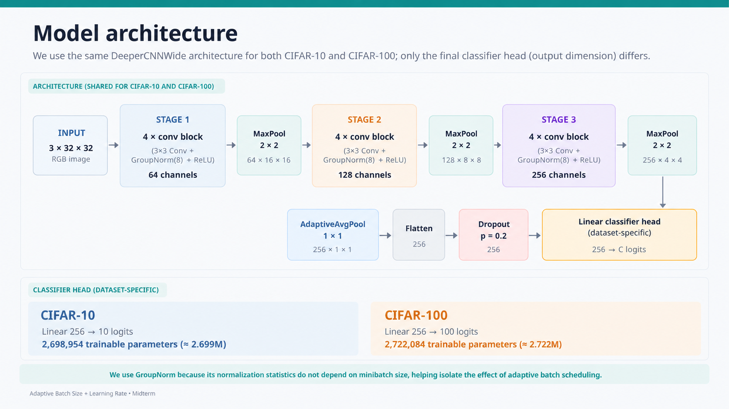
Current: 12 conv layers • Earlier archive: 6 conv layers
Notes:
Describe the current backbone as 12 convolution layers: four 3×3 conv blocks in each of three stages, with channels 64, 128, and 256. GroupNorm is deliberately used so normalization statistics do not depend on minibatch size.
Also point out the architecture progression: the earlier archived runs in data.zip used a 6-convolution-layer CNN, while the current midterm suite uses the 12-layer DeeperCNNWide. Only the final classifier head changes between CIFAR-10 and CIFAR-100.

Slide 8




Adaptive batch-size controller design
Gradient-norm stability + validation plateau determine when the next batch grows.
BATCH CONTROLLER
1 Measure minibatch gradient magnitude
4 Require a validation plateau
Significant improvement:
Lₜ < L_best − Δ, with Δ = 0.01
If meaningful improvement does not occur for the plateau patience window, the validation signal is considered plateaued.
One global gradient-norm value is recorded for each optimizer update.
2 Convert the epoch to a stability signal
5 Grow only when both conditions agree
Lower CV means the minibatch gradient magnitudes were more stable during that epoch.
only if: plateau AND Sₜ ≤ 0.25; otherwise keep Bₜ
3 Smooth over a short history
Allowed batch ladder
Current midterm window: w = 3 epochs. Stability threshold: 0.25.
32
→
64
→
128
→
256
Terminology: this is gradient-norm stability / gradient-norm CV — not the formal gradient noise scale.
Cooldown = 2 epochs after a batch change; the current suite uses grow-only adaptation.
Decision summary: validation plateau + rolling gradient stability ≤ 0.25 ⇒ select the next larger batch for the following epoch.
Adaptive Batch Size + Learning Rate • Midterm
8
Notes:
Walk through the batch controller from left to right. We record the global L2 gradient norm for every optimizer update, summarize the epoch with coefficient of variation, then smooth that signal over three epochs.
The batch only grows when two conditions agree: validation has plateaued and the rolling stability score is at or below 0.25. The current ladder is 32 to 64 to 128 to 256, with a two-epoch cooldown after a change.

Slide 9


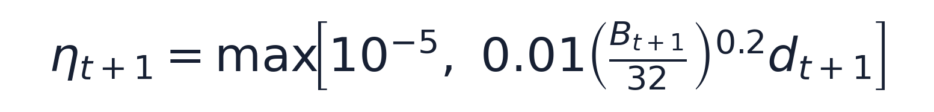
Adaptive learning-rate controller design
Batch-aware LR scaling + validation decay; E4 computes the next LR from the next selected batch.
LR CONTROLLER
1 Batch-aware LR scaling
2 Validation-driven decay multiplier
Validation outcomes are classified as improvement, worsening, or plateau. Consecutive feedback conditions drive a persistent decay multiplier.
Current midterm parameters: reference LR = 0.01 • reference batch = 32 • alpha = 0.2
Sublinear scaling raises the LR as batch size grows, but less aggressively than the linear scaling rule.
when plateau/worsening feedback reaches its patience threshold
Current suite: decay factor = 0.5 • cooldown = 2 • no warmup • LR floor = 1e−5
B=32
B=64
B=128
B=256
0.01000
0.01149
0.01320
0.01516
3 E4 uses the next batch size
Base LR before validation-driven decay
These values explain the 0.0100 → 0.01149 → 0.01320 → 0.01516 growth seen in E4 before decay events.
All prior decay events stay in dₜ; batch growth can still raise the base LR while preserving that decay history.
Validation feedback
→
update decay
→
select next batch
→
compute next LR
→
train next epoch
E4 coupling: use next batch — not current batch — for the next LR.
Adaptive Batch Size + Learning Rate • Midterm
9
Notes:
The LR controller has two components. First, a batch-aware base LR: 0.01 times the batch ratio to the power 0.2. Second, a persistent validation-driven decay multiplier that is halved when the feedback patience condition triggers.
The key E4 coupling is the order of operations: validation feedback updates the state, the next batch is selected, and then the next LR is computed from that next batch. This preserves previous decay events while still allowing batch growth to raise the base LR.

Slide 10
Adaptive controller logic — same rules, different trajectories
The control policy is held constant; the dataset determines when its triggers fire.
METHOD
CIFAR-10
80-epoch trajectory
CIFAR-100
120-epoch trajectory
Batch controller
Batch controller
•
3-epoch rolling mean of within-epoch gradient-norm CV
•
3-epoch rolling mean of within-epoch gradient-norm CV
•
Grow when validation plateaus and CV ≤ 0.25; cooldown = 2
•
Grow when validation plateaus and CV ≤ 0.25; cooldown = 2
Learning-rate controller
Learning-rate controller
•
LR base = 0.01 × (B/32)^0.2
•
LR base = 0.01 × (B/32)^0.2
•
After plateau/worsening patience triggers: decay multiplier × 0.5
•
After plateau/worsening patience triggers: decay multiplier × 0.5
Observed E4
B: 32 → 64 → 128 → 256
first growth after epoch 37
Observed E4
B: 32 → 64 → 128 → 256
first growth after epoch 27
E4 coupling is identical on both datasets: choose B_next first, then compute the LR using that next batch size.
10
Notes:
Now connect the equations to observed behavior. The controller rules are the same on both datasets, but the triggers fire at different times because the validation and gradient-stability trajectories differ.
For E4, CIFAR-10 first grows after epoch 37, while CIFAR-100 first grows after epoch 27. This is the main reason the batch and LR histories diverge even under the same controller logic.

Slide 11
Validation-selected results — side-by-side
Both suites use the same E1–E4 definitions; best checkpoint = lowest validation loss.
RESULTS
CIFAR-10
80 epochs
CIFAR-100
120 epochs
Validation accuracy
Validation accuracy
82.88%
85.02%
86.34%
83.96%
59.42%
64.84%
64.88%
65.02%
E1
E2
E3
E4
E1
E2
E3
E4
Exp
Loss
Macro F1
Best ep.
Exp
Loss
Macro F1
Best ep.
E1
0.524
0.829
74
E1
1.495
0.593
120
E2
0.472
0.851
51
E2
1.312
0.645
40
E3
0.450
0.864
60
E3
1.297
0.648
48
E4
0.487
0.839
50
E4
1.291
0.650
43
Leader: E3 — 86.34%
Leader: E4 — 65.02%
11
Notes:
These are validation-selected checkpoints using the same E1–E4 definitions. On CIFAR-10, E3 has the best selected validation accuracy at 86.34 percent. On CIFAR-100, E4 is narrowly highest at 65.02 percent.
Do not overstate the CIFAR-100 ordering: E2, E3, and E4 are extremely close, and the current results use a single seed.

Slide 12
Efficiency — adaptive batch reduces optimizer updates
Update count is hardware-agnostic; wall-clock time is reported separately.
EFFICIENCY
CIFAR-10
80 epochs
CIFAR-100
120 epochs
Optimizer updates
Optimizer updates
50.0k
50.0k
168.8k
168.8k
28.6k
28.5k
59.3k
59.8k
E1
E2
E3
E4
E1
E2
E3
E4
E2 UPDATE REDUCTION
E4 UPDATE REDUCTION
E2 UPDATE REDUCTION
E4 UPDATE REDUCTION
42.7%
43.1%
64.9%
64.6%
vs E1
vs E1
vs E1
vs E1
Total training time (E1 / E2 / E3 / E4)
Total training time (E1 / E2 / E3 / E4)
432.8 / 398.7 / 432.1 / 401.1 s
1407.5 / 1179.8 / 1343.5 / 1185.5 s
Adaptive batch lowers updates on both datasets — much more strongly in the longer CIFAR-100 run.
12
Notes:
This slide isolates optimization efficiency. Adaptive-batch runs reduce optimizer updates substantially: about 43 percent on CIFAR-10 and about 65 percent on CIFAR-100 compared with E1.
Update count is useful because it is less hardware-specific than wall-clock time. Wall-clock time is still reported separately, since larger batches and implementation overhead can affect actual speed differently.

Slide 13
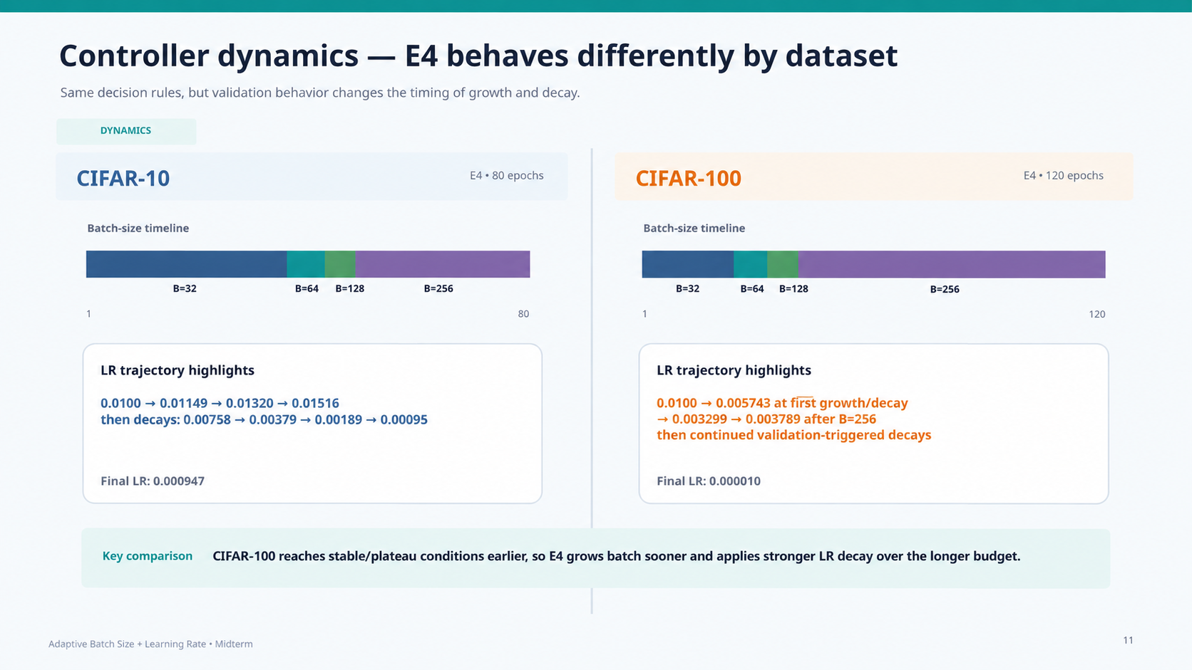
13
Notes:
Use the common color mapping to compare controller trajectories directly: batch 32 is dark blue, 64 teal, 128 green, and 256 purple on both datasets.
CIFAR-100 reaches stable or plateau conditions earlier and spends a larger fraction of training at batch 256. Its longer budget also allows stronger LR decay, ending near the LR floor.

Slide 14
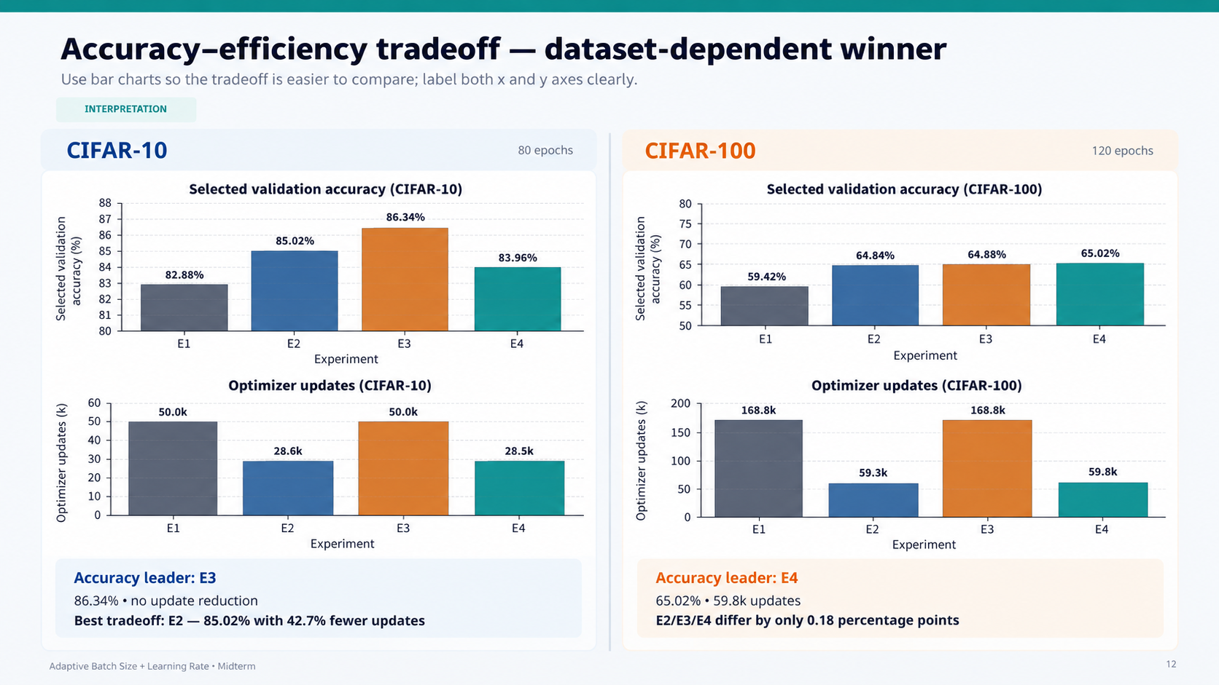
14
Notes:
This slide combines accuracy and optimizer updates using labeled bar charts. On CIFAR-10, E3 is the accuracy leader, while E2 gives the stronger accuracy-efficiency tradeoff because it keeps 85.02 percent accuracy with about 42.7 percent fewer updates.
On CIFAR-100, E4 is narrowly the accuracy leader while E2 and E4 both use roughly 60 thousand updates instead of about 169 thousand for E1 and E3.

Slide 15
What the two datasets say relative to prior work
The cross-dataset comparison supports a conditional — not universal — view of adaptive training.
DISCUSSION
CIFAR-10
Evidence from CIFAR-10
CIFAR-100
Evidence from CIFAR-100
Adaptive LR is strongest
Combined control rises to the top
E3 gives the highest selected accuracy (86.34%).
E4 reaches 65.02%, narrowly above E2/E3.
Goyal / Smith: LR–batch coordination matters.
Supports dynamic joint control.
Adaptive batch saves work
Adaptive batch saves even more work
E2 cuts updates 42.7% while improving over E1.
E2/E4 cut updates by ~65% vs E1.
AdaBatch / Shallue: larger batches can reduce steps.
Longer run amplifies update savings.
Combined control is not automatically best
Differences are very small
E4 saves updates but trails E2/E3 in selected accuracy.
E2–E4 are within 0.18 percentage points.
No universal scaling rule.
Single-seed results do not establish superiority.
Architecture comparison — archived 6-layer CNN vs current 12-layer DeeperCNNWide
CIFAR-10: 6-layer 73.98% → 12-layer 86.34% (+12.36 pp)
CIFAR-100: 6-layer 42.20% → 12-layer 65.02% (+22.82 pp)
Exploratory context only: the archived 6-layer runs in data.zip used different schedules/budgets, so this is not a controlled architecture ablation.
16
Notes:
Relate the dataset results back to prior work. CIFAR-10 favors adaptive LR alone for selected accuracy, while CIFAR-100 slightly favors the combined controller; this supports a workload-dependent rather than universal rule.
The bottom row gives exploratory architecture context from data.zip: the earlier 6-convolution-layer CNN reached 73.98 percent on CIFAR-10 and 42.20 percent on CIFAR-100, whereas the current 12-layer DeeperCNNWide reaches 86.34 and 65.02 percent respectively. Because those archived runs used different schedules and budgets, present this only as contextual evidence, not as a controlled architecture ablation.
The architecture comparison now has its own preceding slide. Refer back to it only as exploratory context; do not describe the 6-layer versus 12-layer difference as a controlled ablation.

Slide 16
Limitations and next steps — compare what remains
The two suites strengthen the story, but they are not yet a statistical study.
NEXT STEPS
CIFAR-10
Current CIFAR-10 suite
CIFAR-100
Current CIFAR-100 suite
Single seed
Seed 42 only.
Single seed
Seed 42 only.
Validation-selected
Official test remains separate for this midterm suite.
Validation-selected
Do not overinterpret E4’s 0.14–0.18 pp edge.
80-epoch budget
May favor a different controller timing than longer training.
120-epoch budget
Not directly pooled with CIFAR-10 because budgets differ.
Next
Repeat seeds; sensitivity analysis; freeze final protocol.
Next
Repeat seeds; matched-budget study; final test after freeze.
Final reporting goal: accuracy + macro F1 + optimizer updates + wall-clock time, with mean ± std across repeated seeds.
17
Notes:
State the limitations clearly. The current suites use a single seed, and the epoch budgets differ between CIFAR-10 and CIFAR-100, so the datasets should not be pooled into one statistical comparison.
The next step is repeated seeds, matched-budget sensitivity experiments, and a frozen final protocol before final test reporting.

Slide 17
Midterm takeaway — the answer changes by dataset
The system works on both tasks, and the comparison reveals the tradeoff more clearly.
CONCLUSION
CIFAR-10
CIFAR-10 • 80 epochs
CIFAR-100
CIFAR-100 • 120 epochs
BEST ACCURACY
BEST TRADEOFF
BEST ACCURACY
FEWEST UPDATES
86.34%
E2
65.02%
59.3k
E3: adaptive LR
85.02% • −42.7% updates
E4: adaptive batch + LR
E2: −64.9% vs E1
Interpretation
Interpretation
Adaptive LR gives the strongest selected accuracy. Adaptive batch adds a clear optimization-step advantage, but combining both does not yet improve selected accuracy.
E4 is narrowly best in selected accuracy while retaining the large update reduction of adaptive batch training. E2/E3/E4 remain extremely close.
Overall: adaptive training is useful, but there is no evidence yet that one controller universally dominates. The workload determines the accuracy–efficiency tradeoff.
18
Notes:
Close with the cross-dataset result rather than declaring one universal winner. On CIFAR-10, adaptive LR gives the strongest selected accuracy and adaptive batch gives clear update savings. On CIFAR-100, E4 is narrowly best while retaining most of the adaptive-batch efficiency gain.
The main conclusion is that adaptive training is useful, but the best controller configuration depends on the workload and training budget.
After the conclusion, transition to the deployed demo slide and invite the audience to open the GitHub Pages link or scan the QR code.

Slide 18

Deployed midterm demo
Public GitHub Pages deployment for the project presentation and Q&A.
LIVE DEMO
● ● ●
https://tharunswaminathan.github.io/adaptive-batch-lr-cifar10/
SCAN TO OPEN
Adaptive Batch Size + Learning Rate
Midterm project demo
Open during the presentation to show the deployed project page.
The link is clickable in PowerPoint and the QR code can be scanned from the screen.
GitHub Pages deployment
tharunswaminathan.github.io
/adaptive-batch-lr-cifar10/
Adaptive Batch Size + Learning Rate • Midterm
19
Notes:
This is our deployed midterm demo. The public GitHub Pages URL is shown on the slide and is also encoded in the QR code. During the talk, either click the URL from PowerPoint or let the audience scan the QR code.
Keep the live portion short and use it to demonstrate that the project is deployed and reproducible. If internet access is unreliable, continue with the presentation slides rather than spending time troubleshooting the live site.

Slide 19
References
Core literature used to motivate batch-size, learning-rate, and adaptive-control choices.
REFERENCES
Generalization & scaling
Adaptive & workload-aware training
1
Keskar et al. (2017) — On Large-Batch Training for Deep Learning.
5
Devarakonda, Naumov & Garland (2018) — AdaBatch.
2
Hoffer, Hubara & Soudry (2017) — Train Longer, Generalize Better.
6
Masters & Luschi (2018) — Revisiting Small Batch Training.
3
Goyal et al. (2017/2018) — Accurate, Large Minibatch SGD.
7
McCandlish et al. (2018) — An Empirical Model of Large-Batch Training.
4
Smith et al. (2018) — Don’t Decay the Learning Rate, Increase the Batch Size.
8
Shallue et al. (2019) — Measuring the Effects of Data Parallelism.
These papers motivate both CIFAR-10 and CIFAR-100 experiments; dataset-specific results are kept separate rather than pooled.
20
Notes:
Use this as the reference or backup slide. The cited papers motivate the batch-size/generalization debate, batch-LR coupling, progressive batch growth, and workload-aware adaptation.
If asked about the gradient-noise literature, reiterate that our implementation uses gradient-norm CV rather than the formal gradient noise scale.
The deployed demo appears on the preceding slide; this final slide is for literature questions and citations.

